Slide 1
Molecules of Life
Part A: Review of essential chemistry
Elements
Electronegativity
Bonds
Organic molecules
All images are from Wikimedia Commons, unless otherwise noted.
Notes:
<number>

Slide 2
elemental abundance: human body ocean water
Element | Proportion (by mass)
Oxygen | 65% | 86%
Carbon | 18% | 0.0028%
Hydrogen | 10% | 11%
Nitrogen | 3% | 0.0016%
Calcium | 1.5% | 0.04%
Phosphorus | 1.2% | 0.000006%
Potassium | 0.2%
Sulfur | 0.2%
Chlorine | 0.2%
Sodium | 0.1%
Magnesium | 0.05%
Iron | < 0.05%
Cobalt | < 0.05%
Copper | < 0.05%
Zinc | < 0.05%
Iodine | < 0.05%
Selenium | < 0.01%
Fluorine | < 0.01%

Slide 3
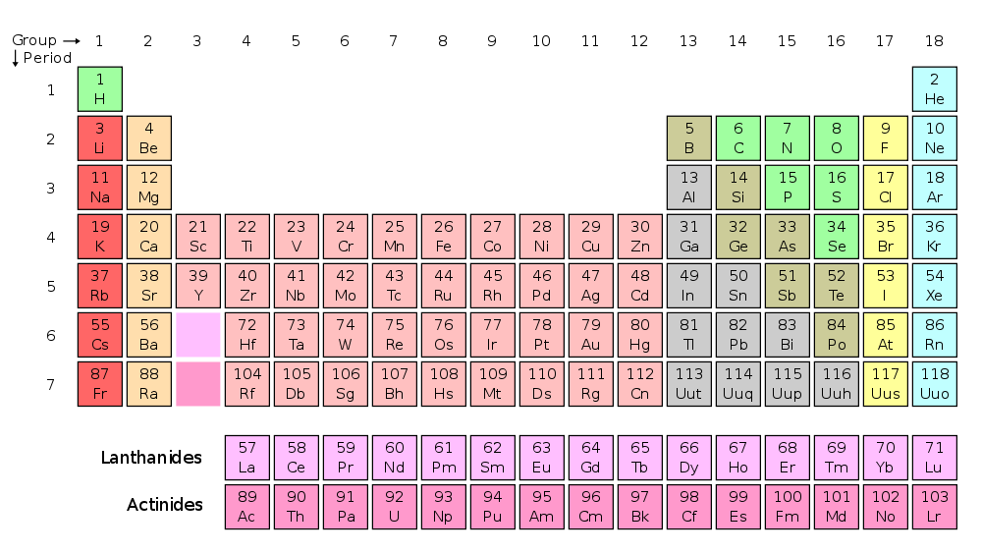
Periodic table of the elements

Slide 4
What determines what kind of bond forms between atoms?
Element | Electro-negativity
O | 3.44
N | 3.04
S | 2.58
C | 2.55
H | 2.20

Slide 5
How do molecules behave in water?

Slide 6
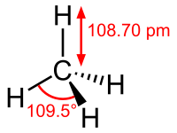
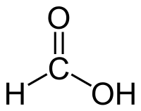
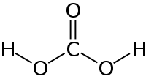
Which of these are organic molecules?
A. methane
B. carbon dioxide
C. carbonic acid
D. formic acid
Notes:
<number>

Slide 7
What is the difference, then, between organic carbon and inorganic carbon?
“The purpose of life is to hydrogenate carbon dioxide” – Sean Carroll
“The purpose of life is to hydrogenate carbon dioxide” – Sean Carroll

Slide 8
Molecules of Life
Part B: Four major kinds of molecules make up the bulk of a cell
Carbohydrates
Nucleic acids
Lipids
Proteins

Slide 9
Sources: Watson JD: Molecular Biology of the Gene, 2nd ed., Philadelphia, PA: Saunders, 1972
Freitas RA Nanomedicine, 1998, http://www.foresight.org/Nanomedicine/Ch03_1.html
Ushiyama K: Plant Cell Culture in Japan, p. 97 (1991). Eds. Komamine, A., CMC Co. Ltd., Tokyo, Japan

Slide 10
Macromolecules (very large molecules)
What are the major types of biological macromolecules and their subunits (building blocks)?
What physico-chemical forces or interactions affect the structure and function of each type of macromolecule (particularly proteins)?
How do variations in structure/composition of macromolecules affect their function and the adaptation of the organism to its environment?
http://jchoigt.wordpress.com/2010/10/01/biomolecules/
Notes:
<number>

Slide 11
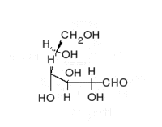
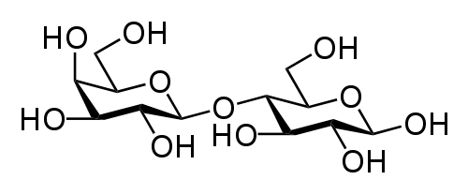
Carbohydrates, glycans, polysaccharides
http://en.wikipedia.org/wiki/File:Glucose_Fisher_to_Haworth.gif
lactose

Slide 12
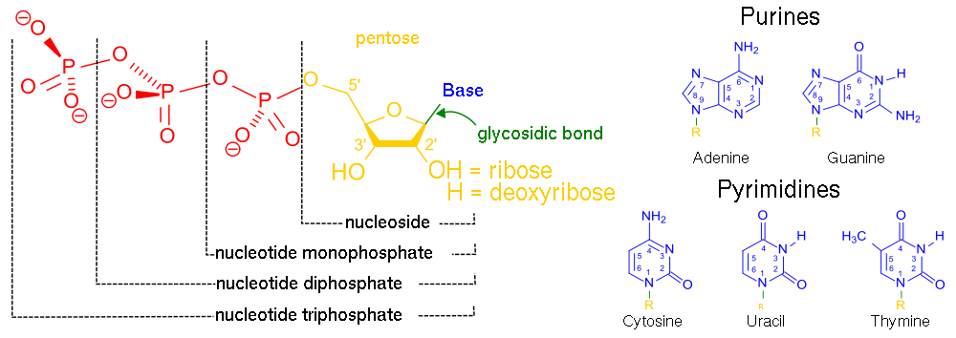
Nucleic acids (DNA and RNA)

Slide 13
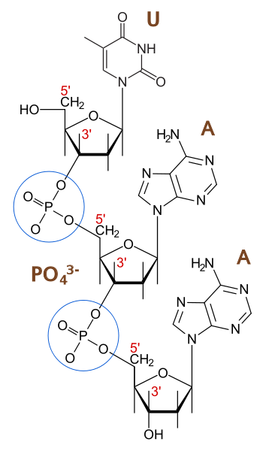
Phosphodiester bonds
T

Slide 14
 | Glycans (polysaccharides) | Proteins (polypeptides) | Nucleic acids (DNA and RNA)
Subunits | monosaccharides
Elemental Composition |  | C, H, N, O, S
Bonds between subunits |  |  | Phosphodiester
Structure
Cellular functions
Notes:
<number>

Slide 15
Molecules of Life
Part C: Protein structure
Amino acids
Peptide bonds
Levels of protein structure
Hemoglobin example

Slide 16
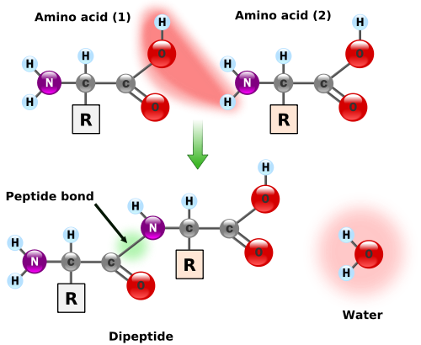
Proteins (polypeptides) are made as linear chains of amino acids linked by peptide bonds
Notes:
<number>

Slide 17
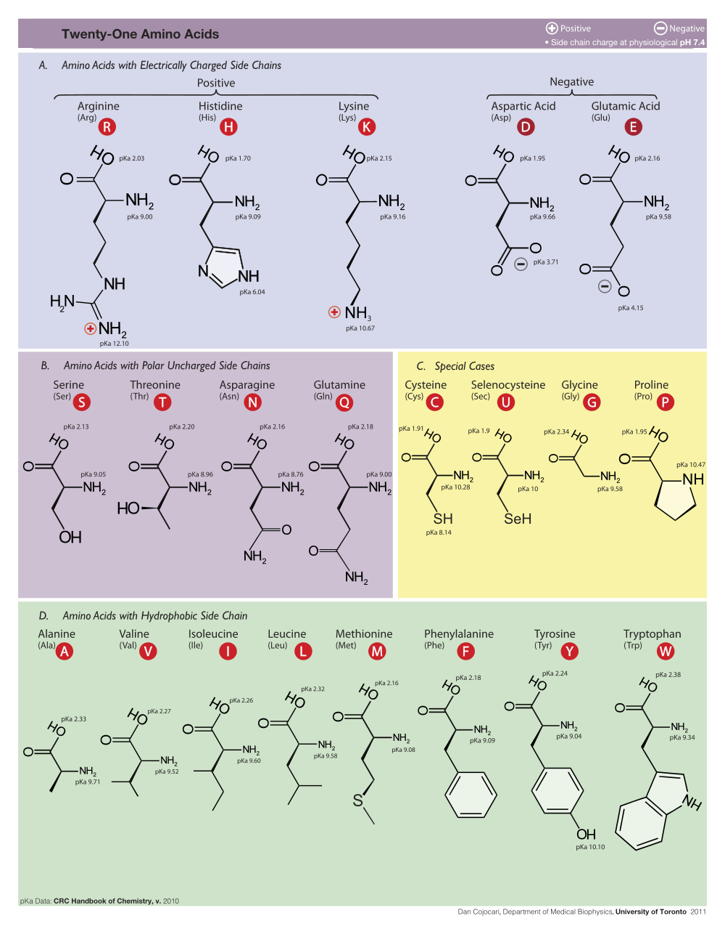
Nonpolar amino acids - hydrophobic
Notes:
<number>

Slide 18
Polar amino acids - hydrophilic
Dan Cojocari, Dept Medical Biophysics, U. Toronto 2011 Wikimedia Commons
Notes:
<number>

Slide 19
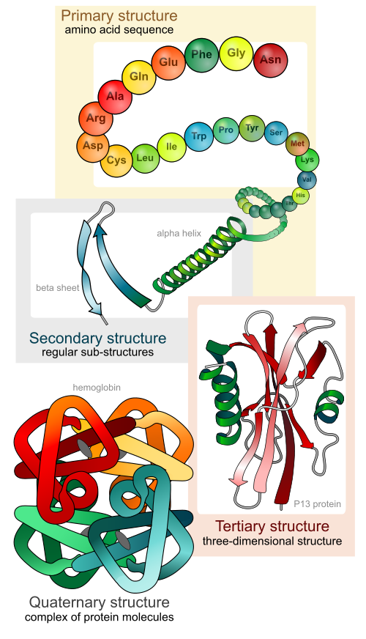
Protein structure
Notes:
<number>

Slide 20
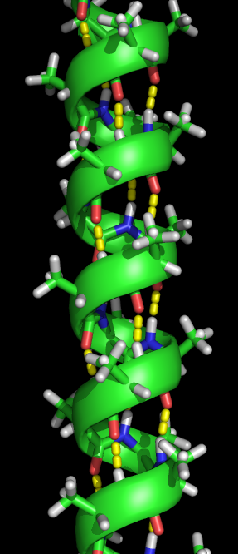
Secondary structure: alpha-helix

Slide 21
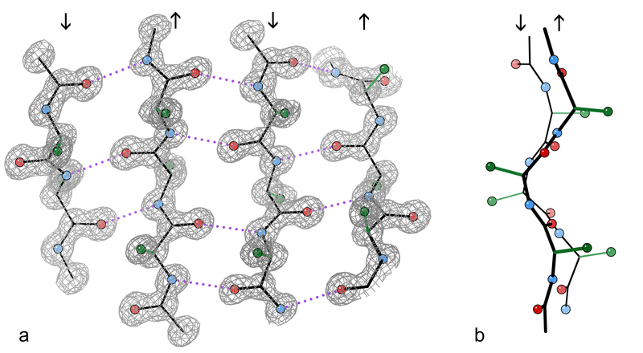
Secondary structure: beta-sheet

Slide 22
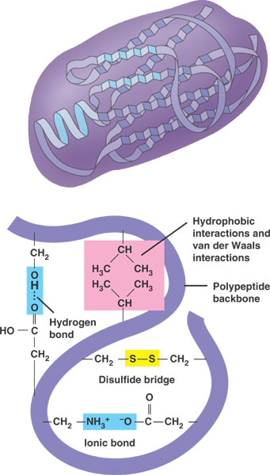
What holds the tertiary structure together?
Campbell Biology, 8th ed.
Notes:
<number>

Slide 23
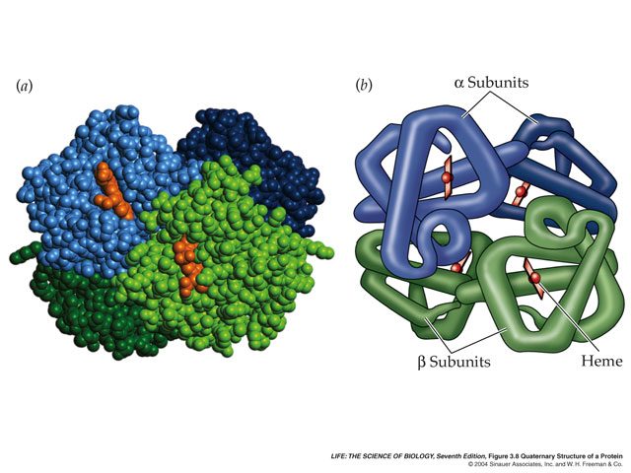
Protein structure and function example – sickle cell hemoglobin
http://gingi.uchicago.edu/hbs2.html
Notes:
<number>

Slide 24
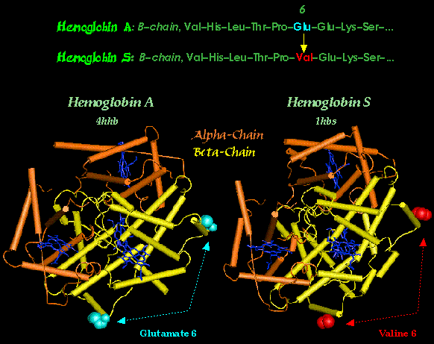
Hemoglobin S differs from Hemoglobin A at what levels of protein structure?
http://www.carnegieinstitution.org/first_light_case/horn/lessons/sickle.html
Notes:
<number>

Slide 25
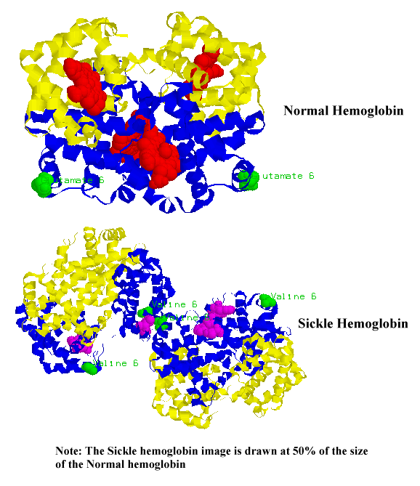
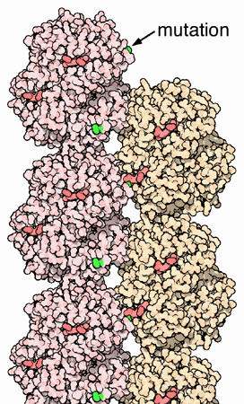
Valine 6 causes additional interactions
Wikipedia
http://www.carnegieinstitution.org/first_light_case/horn/lessons/sickle.html
Notes:
<number>

